Slide 1
Stakeholder and Gap analysis - Activity pack

Slide 2
Activity slide guidelines
Use the slides to summarise results from the spreadsheet activities
Add more slides as needed

Slide 3
Activity 1: Stakeholder identification

Slide 4
Activity 2: Stakeholder interactions

Slide 5
Activity 3: Stakeholder analysis

Slide 6
Activity 4: Stakeholder engagement

Slide 7
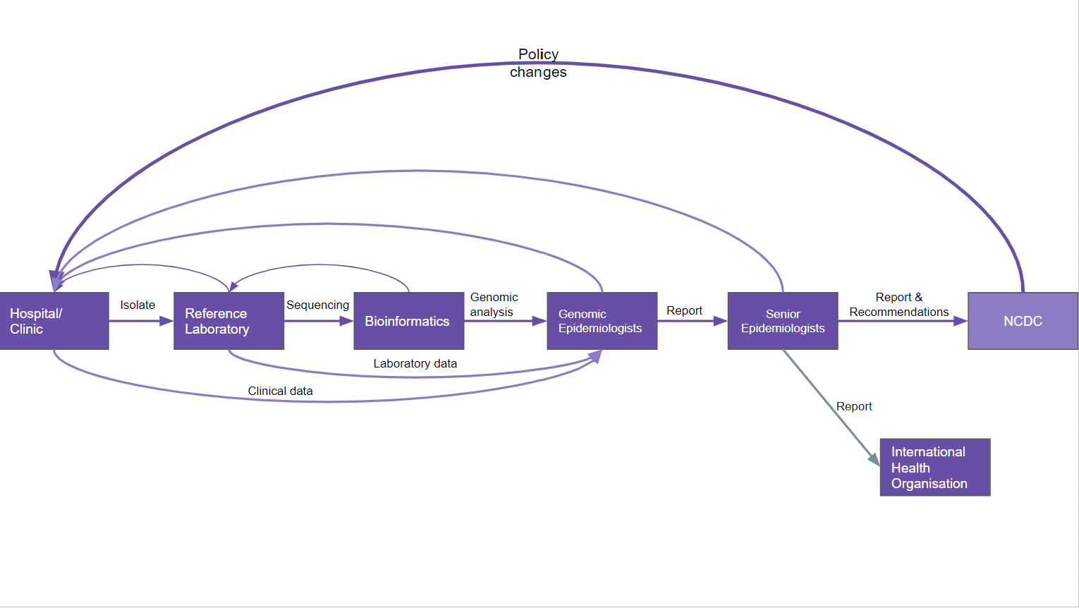
Gap Analysis - Current Situation
Copy and paste your system architecture here over the placeholder

Slide 8
Activity 5: Current situation, gaps and causes

Slide 9
Activity 6: Action plan

